Slide 1

Flora Sense
AI Based Plant Solution
Guided By:
Gagandeep Ma’am
Team Members:
Anuj Goyal
Ayush Shrivastava
Satyam Verma
Silky Das

Slide 2
Problem Statement
In our natural environment, a multitude of plant species remains obscure to the untrained eye of the everyday observer
To address these challenges, our project endeavors to harness the capabilities of Artificial Intelligence
Specifically, we aim to create an AI system that can identify plant species and determine their health status by recognizing signs of disease or distress

Slide 3
Objectives
Species Identification: Develop an AI system capable of accurately identifying a diverse range of plant species through image analysis and classification
Data Aggregation: Gather and curate an extensive dataset comprising plant images, taxonomic information, and geographical data to train and validate our AI model
Disease Detection: Implement advanced AI algorithms for the detection and diagnosis of illnesses or adverse conditions affecting identified plant specimens
User-Friendly Interface: Design an intuitive and accessible user interface that enables users to capture plant images and receive real-time species identification and health assessments

Slide 4
Objectives
Accuracy and Reliability: Ensure the AI system achieves a high level of precision in both species recognition and disease detection, instilling trust among users
Timely Notifications: Enable the AI system to provide prompt notifications and actionable recommendations when signs of plant diseases or distress are detected, facilitating timely intervention and care
Educational Resources: Incorporate educational content to enhance users' understanding of various plant species and common plant health issues, promoting environmental awareness and conservation
Scalability: Develop the AI system with scalability in mind, allowing for future expansion to include more plant species and diseases

Slide 5
Objectives
Continuous Enhancement: Establish mechanisms for ongoing learning and refinement of the AI model through user feedback, additional data acquisition, and regular updates
Collaborative Partnerships: Seek collaboration with experts and organizations in botany, conservation, and agriculture to improve accuracy and contribute to scientific research and biodiversity conservation

Slide 6
Feasibility Study
Before embarking on this project, we conducted a comprehensive feasibility study
Our analysis demonstrated the technological feasibility of implementing an AI-driven plant recognition and disease detection system
Advancements in computer vision and machine learning have made it possible to achieve our objectives

Slide 7
Need and Significance
The need for this project arises from the limited ability of the general public to identify plant species and diagnose plant diseases accurately
Additionally, in an era of increasing environmental concern, fostering awareness about plant biodiversity and health is of utmost significance
Our project addresses this need by providing a user-friendly solution

Slide 8

Intended User
Our intended user base includes: Nature enthusiasts Home gardeners Botanists Farmers Conservationists Educational institutions

Slide 9
Literature Review
Our literature review extensively covers existing AI-driven plant recognition and disease detection systems
We explore relevant research papers, technologies, and methodologies, highlighting gaps and opportunities that inform our project's approach

Slide 10
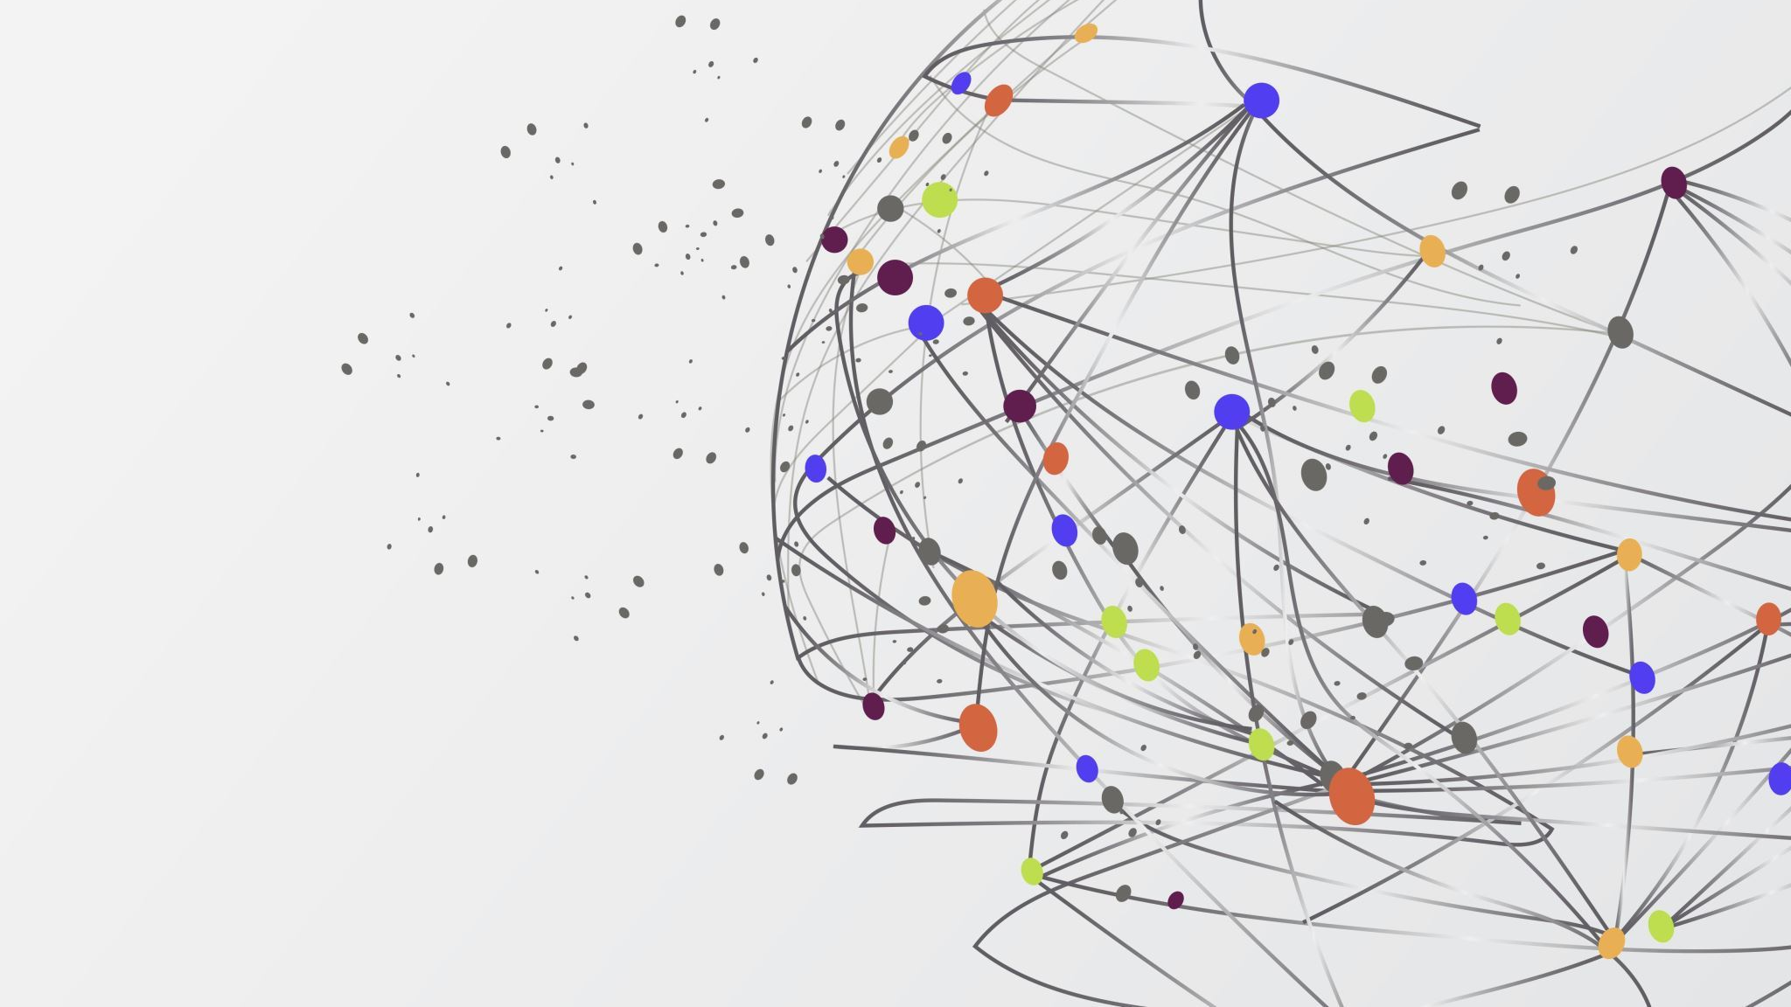
Proposed Methodology in Brief

Slide 11
Functional Requirements
Modules Our project consists of the following modules: Image Acquisition: Capture plant images using a user-friendly interface
Disease Detection: Implement AI algorithms to detect and diagnose plant diseases
Educational Content: Provide educational resources on plant species and diseases

Slide 12
Non-functional Requirements
Usability Our system will offer an intuitive and user-friendly experience
Efficiency Accuracy Achieve high accuracy in species recognition and disease detection
Performance Ensure the system's performance meets user expectations

Slide 13
Reliability
Guarantee the system's reliability for timely notifications and alerts
Maintainability Design the system for easy maintenance and updates
Security Implement security measures to protect user data and system integrity

Slide 14
Hardware Requirements
Our system will require standard computing hardware, including CPUs and GPUs, for AI processing
Software Requirements:
Minimum Android Version: 8.0 or Browser

Slide 15

Back End
Front End
Development: HTML, CSS, JS
Frameworks: React, React Native
Development: Python, Flask Database: MongoDB AI Frameworks: TensorFlow, PyTorch

Slide 16
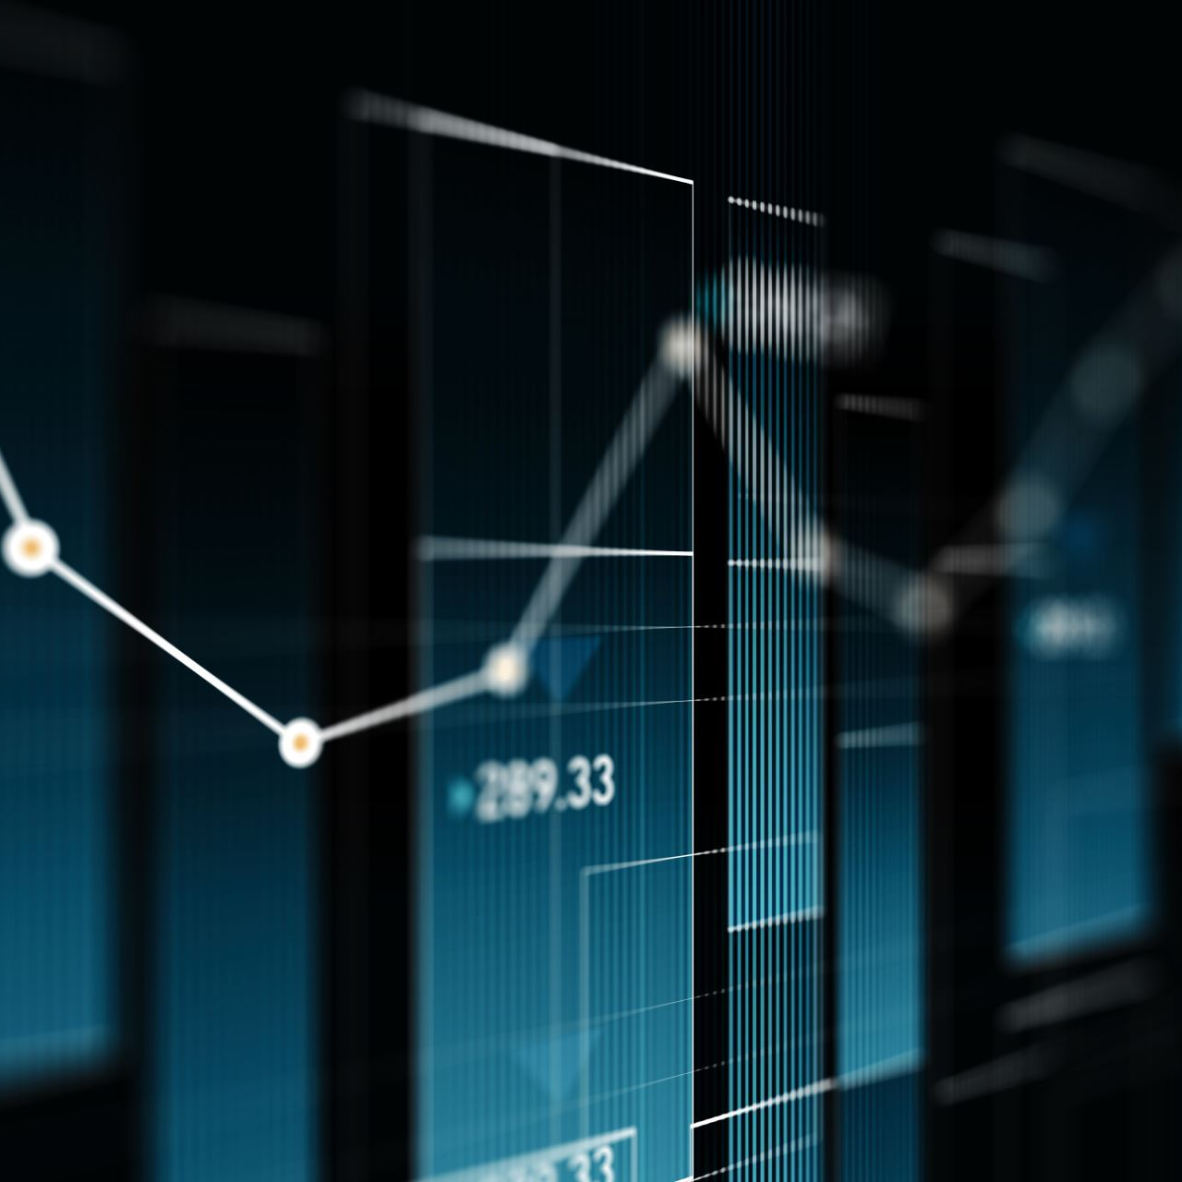
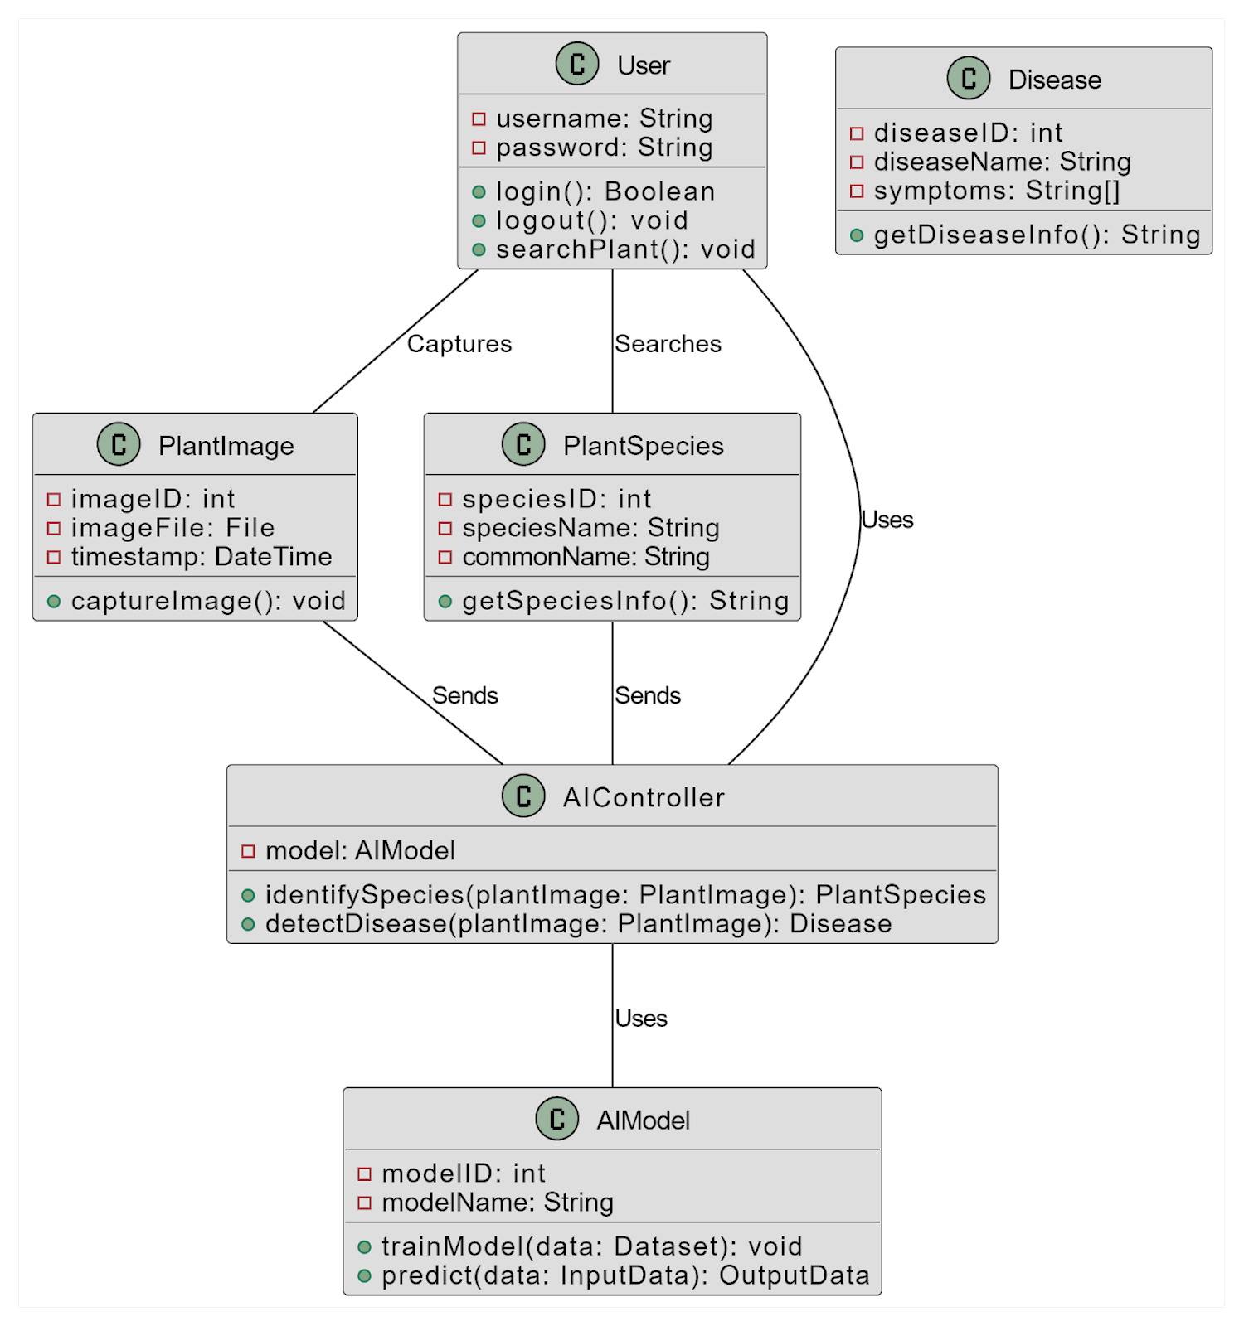
Case Diagram

Slide 17
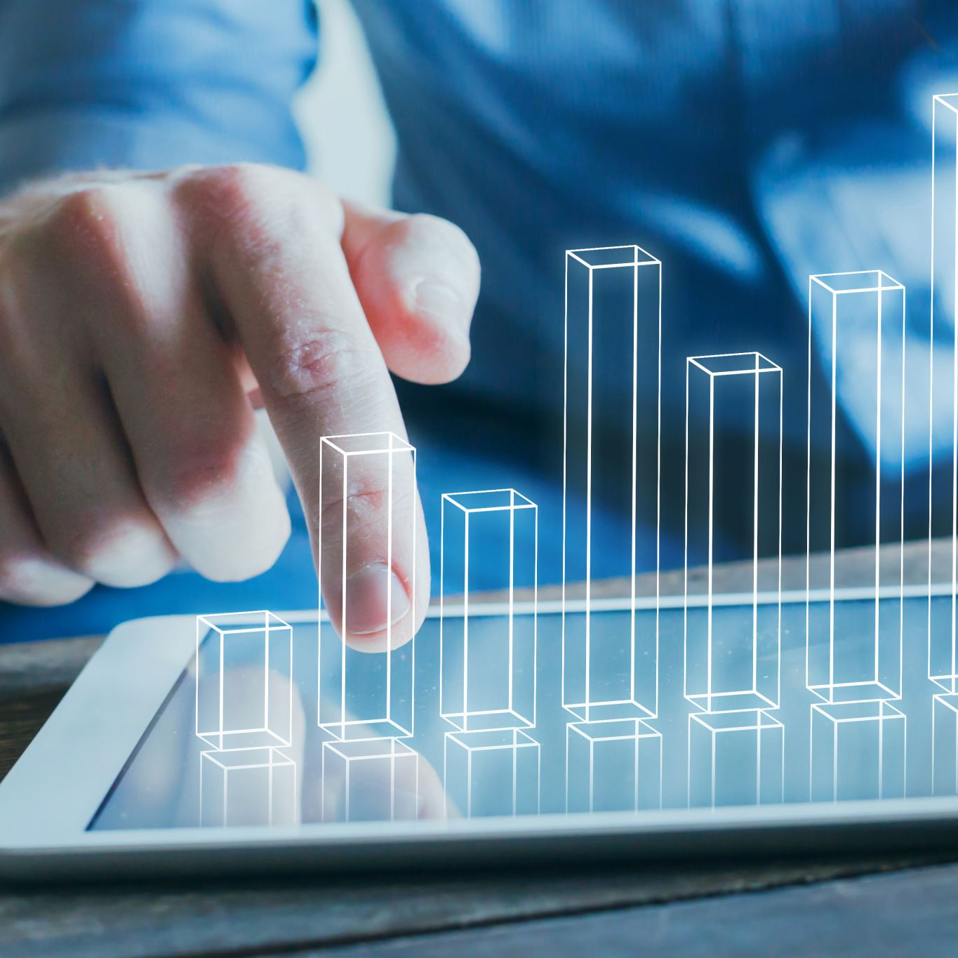
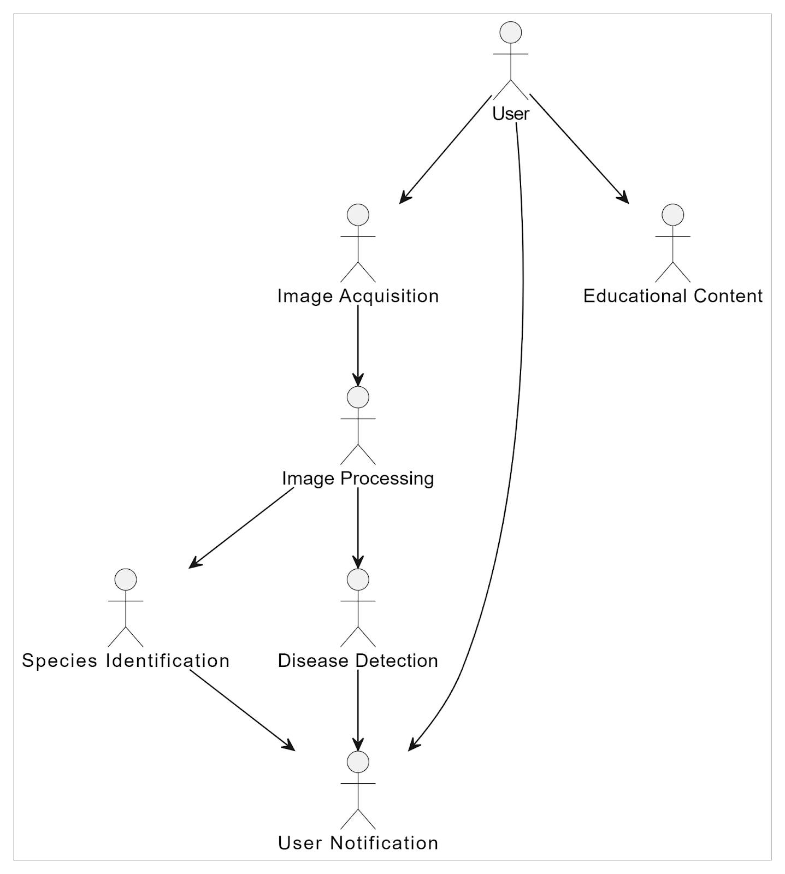
Use Case Diagram

Slide 18
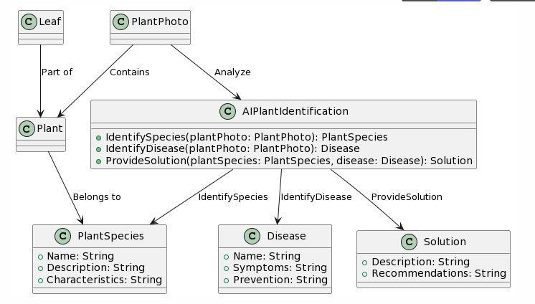
Data Flow Diagram
References

Slide 19
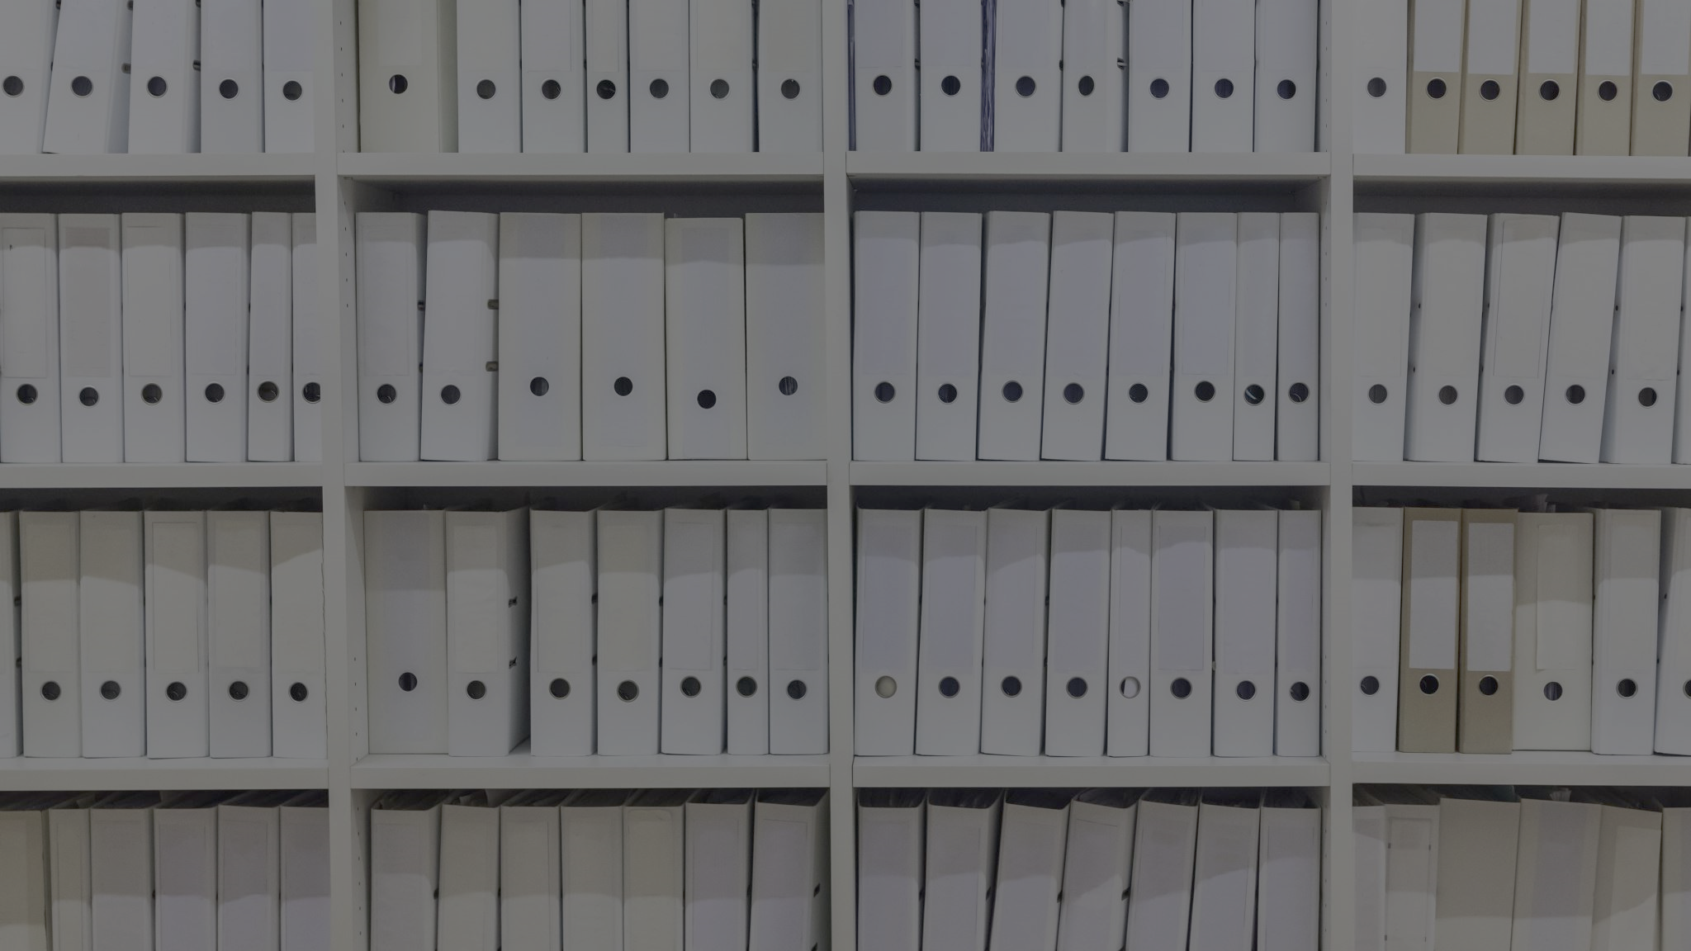
References
PlantCLEF Models: https://www.imageclef.org/PlantCLEF2021
Tensorflow: https://www.tensorflow.org/api_docs
Bard for the research purpose

